Slide 1
Java Collection Framework
Object Oriented Development
with Java
(CT038-3-2 and Version VC1)
Java Collection APIs

Slide 2
Topic & Structure of The Lesson
Collections
Collection Interface
Set Interface
Hash set
Linked Hash set
Tree set
List
ArrayList
-Vector

Slide 3
Learning outcome
At the end of this lesson, you will be able to
Work with Java Collections Framework
Understand Generic type
Use Collections and Arrays classes

Slide 4
Key terms you must be able to use
If you have mastered this topic, you should be able to use the following terms correctly in your assessments:
-Collections
-Hash set
-Tree set
-List
-ArrayList
-Vector

Slide 5
Introduction
Java API can organise and manipulate data efficiently through interfaces and classes.
These interfaces and classes:
Java Collections Framework (JCF).
We will learn how to use these classes and interfaces in this lesson.

Slide 6
Collection
A collection is a container object that stores a group of objects, often referred to as elements.
JCF supports three types of collections: set, list, and map.
They are made up by interfaces and classes. E.g., Set interface and its HashSet class.

Slide 7
Cont’d
An instance of Set stores a group of nonduplicate elements.
An instance of List stores an ordered collection of elements.
An instance of Map stores a group of objects, each of which is associated with a key.
Note: Collection accepts only object reference type, not primitive type.

Slide 8
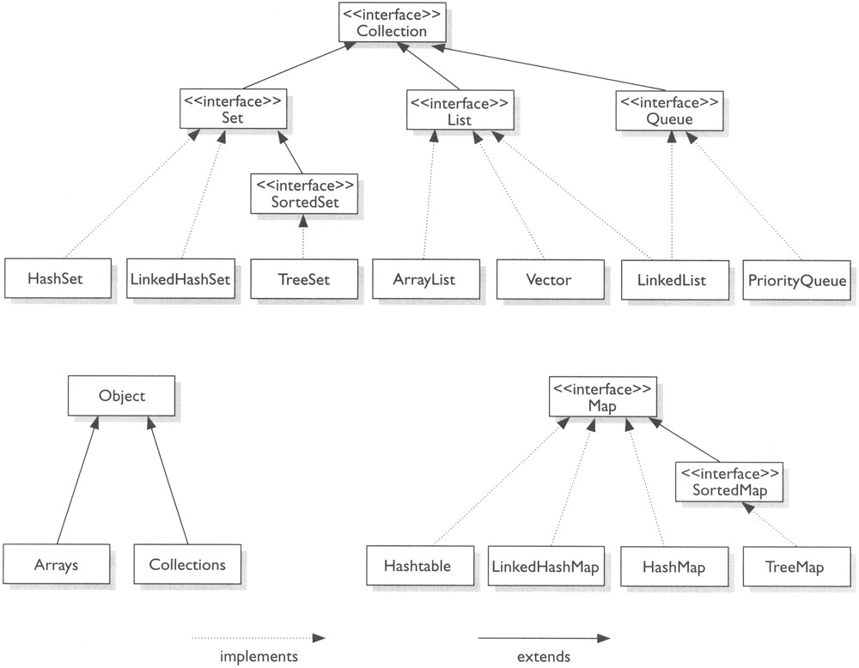

Slide 9
Collection interface
Is the roof interface for manipulating a collection of objects.
Provides basic operations for adding and removing elements in a collection.
The add method adds an element to the collection.
The addAll method adds all the elements in a specified collection to this collection.
And remove and removeAll methods.
More operations: http://docs.oracle.com/javase/7/docs/api/

Slide 10
Set interface
Set interface extends Collection interface.
The concrete classes that implement Set must ensure that no duplicate elements can be added to the set.
That is no two elements e1 and e2 can be in the set.
3 concrete classes:
HashSet, LinkedHashSet and TreeSet

Slide 11
HashSet class
HashSet class is a concrete class that implements Set.
You can create a HashSet using its no-arg constructor.
Its duplicate-free.
No particular order for the elements in a hash set.
To impose an order elements, LinkedHashSet class can be used.

Slide 12
Cont’d
public static void main(String... args){
Set set = new HashSet();
String text = "Have a good day. Have a good class. Have a good visit. Have fun!";
StringTokenizer st = new StringTokenizer(text, “ .!?”);
while(st.hasMoreTokens()){
set.add(st.nextToken());
}
System.out.println(set);
//obtain an iterator for the hash set
Iterator iterator = set.iterator();
while(iterator.hasNext()){
System.out.println(iterator.next() + " ");
}//while
}
//Output [day, Have, a, class, fun, good, visit] day Have a class fun good visit

Slide 13
LinkedHashSet class
LinkedHashSet class extends HashSet with a linked list implementation that supports an ordering of the elements in the set.
The elements in a HashSet are not ordered, but LinkedHashSet’s are ordered in which they are inserted.

Slide 14
Cont’d
public static void main(String... args){
Set set = new LinkedHashSet();
String text = "Have a good day. Have a good class. Have a good visit. Have fun!";
StringTokenizer st = new StringTokenizer(text, “ .!?”);
while(st.hasMoreTokens()){
set.add(st.nextToken());
}
System.out.println(set);
//obtain an iterator for the hash set
Iterator iterator = set.iterator();
while(iterator.hasNext()){
System.out.println(iterator.next() + " ");
}//while
}
//Output [Have, a , good, day, class, visit, fun] Have a good day class visit fun

Slide 15
TreeSet class
TreeSet is a concrete class that implement SortedSet interface.
You can use its no-arg constructor or new TreeSet(Collection).
You can add objects into a tree set as long as they can be compared with each other.
They are two ways to compare objects:

Slide 16
Cont’d
Use the Comparable interface.
They can be compared using compareTo method.
For example, String class and all the wrapper classes for primitive types, implement the Comparable interface.
Specify a comparator for the elements in the set.
Create a custom Comparator class.

Slide 17
Cont’d
public static void main(String... args){
Set set = new HashSet();
String text = "Have a good day. Have a good class. Have a good visit. Have fun!";
StringTokenizer st = new StringTokenizer(text, “ .!?”);
while(st.hasMoreTokens()){
set.add(st.nextToken());
}
TreeSet treeSet = new TreeSet(set);
System.out.println(treeSet);
//obtain an iterator for the hash set
Iterator iterator = treeSet.iterator();
while(iterator.hasNext()){
System.out.println(
iterator.next() + " ");
}//while
}
//Output [Have, a, class, day, fun, good, visit] Have a class day fun good visit

Slide 18
Cont’d
HashSet performs more efficient to insert and remove elements.
A runtime error (ClassCastException) may be happened if you add an object that is not comparable with the existing objects in the tree set.

Slide 19
Enhanced for-loop
Iterator iterator = set.iterator();
while(iterator.hasNext()){
System.out.println(iterator.next() + " ");
}//while
You can simplify the code using enhanced for loop without using iterator.
for(Object e : set){
System.out.println(e.toString() + “ “);
}

Slide 20
List interface
To allow duplicate elements to be stored in a collection.
To access elements by an index.
List interface extends Collection to define an ordered collection with duplicate allowed.

Slide 21
ArrayList class
ArrayList stores elements in an array.
The array is dynamically created.
If the capacity of the array is exceeded, create a large new array and copy all the elements from current array to the new array.
0 | 1 | 2 | 3 | 4 | 5 | 6 | 7

Slide 22
LinkedList class
LinkedList stores elements in a linked list.
Node reference implementation where Node class has two portion of data (data and nextRef).

Slide 23
Application
Which of the two classes you use depends on your specific needs.
If you need to support random access through an index without inserting and removing elements, ArrayList is more efficient collection.
If application requires insertion and deletion of elements in the list, LinkedList is suitable.

Slide 24
Vector class
In Java 2, Vector class is the same as ArrayList, except that it contains synchronized methods for accessing and modifying vector.
Synchronized method can prevent data corruption when a vector is accessed or modified by two or more threads concurrently.
Use ArrayList class if you don’t need synchronization. It works much faster.

Slide 25
Stack class
Stack is implemented as an extension of Vector.
Basic operations:
isEmpty() – returns boolean if stack is empty.
peek() – returns the top element of the stack without removing it.
pop() – removes the top element from the stack and returns it.

Slide 26
Cont’d
push() – adds the specified element to the stack.
search() – check the specified element is in the stack.
etc.

Slide 27
Using Generic Type
Introduced in Java 5.
Support type checking at compile time.
Object type is determined when the Collection object is constructed.
E.g.,
HashSet<String> set = new HashSet<String>();

Slide 28
Cont’d
if you attempt to add non-string, a compile time error would occur.
set.add(new Integer(2));

Slide 29
Cont’d
No casting is required. E.g.,
ArrayList<Double> list = new ArrayList<Double>();
list.add(5.5);
list.add(3.2);
Double doubleObj = list.get(0);
double d = list.get(1);

Slide 30
Map interface
Map interface maps keys to the elements.
The keys are like indexes.
In List, indexes are Integers.
In Map, keys can be any objects.
A map cannot contain duplicate keys.
Each key maps to one value.
Operations: querying, updating, and obtaining a collection of values and a set of keys.

Slide 31
Cont’d
Update methods include:
clear – removes all the mappings
put – associates the specified value with the specified key
putAll – adds the specified map to this map
remove – remove the map elements for the specified key

Slide 32
Cont’d
Query methods include:
containsKey – checks whether the map contains a mapping for the specified key
containsValue – checks whether the map contains a mapping for this value
isEmpty – checks the maps contains any mappings.
size – returns the number of mappings in the map

Slide 33
Cont’d
More methods:
keySet
values
entrySet
Etc.

Slide 34
Cont’d
Classes:
HashMap,
LinkedHashMap,
TreeMap
HashMap class is efficient for locating a value, inserting a mapping and deleting a mapping.
LinkedHashMap (Java 4) extends HashMap with linked list implementation that supports an ordering of the entries in the map.

Slide 35
Cont’d
TreeMap implements SortedMap, is efficient for traversing the keys in a sorted order.
The keys are sorted using the Comparable or Comparator interface.

Slide 36
Cont’d
E.g.,
HashMap hashMap = new HashMap();
hashMap.put(“Smith”, new Loan(7, 15, 120000));
hashMap.put(“Anderson”, new Loan(9, 30, 200000));
hashMap.put(“Lewis”, new Loan(2, 25, 125000));

Slide 37
Collections class
Collections class contains static methods for operating on collections and maps.
Most of the methods deal with lists.
sort methods can be used to sort a list using the Comparable interface or the Comparator interface.
More methods…

Slide 38
Arrays class
Arrays class contains various static methods for sorting and searching arrays, comparing arrays, and filling arrays elements.
It also contains a method for converting an array to a list.

Slide 39
Quick Review Questions
Describe Java Collection Framework.
How do you create an instance of Set?
What are the differences between HastSet, LinkedHastSet and TreeSet?
How do you traverse the elements in a set?
List the implemented classes of List interface.
Describe and compare HashMap, LinkedHashMap, and TreeMap.

Slide 40
Summary of Main Teaching Points
- Collections
-Hash set
-Tree set
-List
-ArrayList
-Vector

Slide 41
Q & A

Slide 42
Next Session
UML diagrams
-Usecase diagram
-Class diagram
-Activity diagram

